Slide 1
PROTOTYPE ASSEMBLER
Team 6

Slide 2
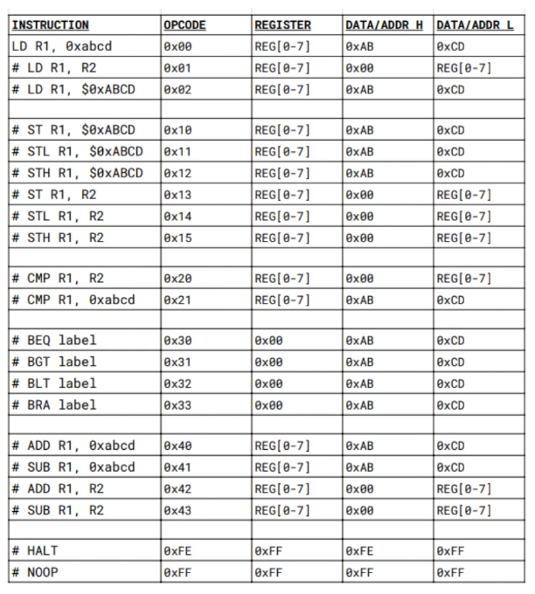
Instruction set
32 bit instructions
R0 – R7 registers
Little endian
Two pass assembler

Slide 3
Assembler features
Live assembler console
Input as file
Output as file

